Slide 1



Fundamental Ideas of Machine Learning
Regression
Berta Böjte
16 MPH

Slide 2
What is Data Science, what does it include?
Data Science: Extracting knowledge and (actionable) insight from (generally raw) data
Artificial Intelliegnce: any system that perceives its environment and takes actions that maximize its chance of achieving its goals
Machine Learning: computer algorithms that automatically improve their own performance with additional data/experience
Deep Learning: Deep learning is part of a broader family of machine learning methods based on artificial neural networks with representation learning.
Statistics: the study and manipulation of data, including ways to gather, review, analyze, and draw conclusions from data. The two major areas of statistics are descriptive and inferential statistics.
Exploratory Data Analysis: performing initial investigations on data to discover patterns, spot anomalies, test hypothesis and check assumptions with the help of summary statistics and graphical representations.
Artificial Intelligence
Machine Learning
Deep Learning
Statistics
Exploratory Data Analysis
Vizualization (basic)
Notes:
Berta

Slide 3




High level overview of ML categories
Supervised
Unsupervised
Reinforcement
Description
Description
Description
To predict a target variable in the future
To find patterns in the data that can be used to simplify a task
To teach the machine something in a kind of „human learning” way
Types and algorithms
Types and algorithms
Types and algorithms
Classification – predict a label
Logistic regression
Decision Trees
Anomaly detection
Isolation forest
Clustering
K-means
Hierarchical clustering
Action-reward based learning
Monte Carlo
Q-learning
SARSA
Regression – predict a continuous number
Linear regression
Decision Trees
Wrong
Wrong
Input data
Yes
Output
No
Input data
$ 20.0 M
Right
$ 15.8 M
$ 32.3 M
Notes:
Berta

Slide 4
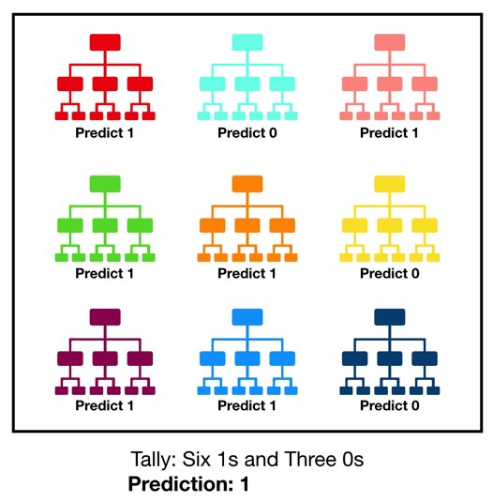

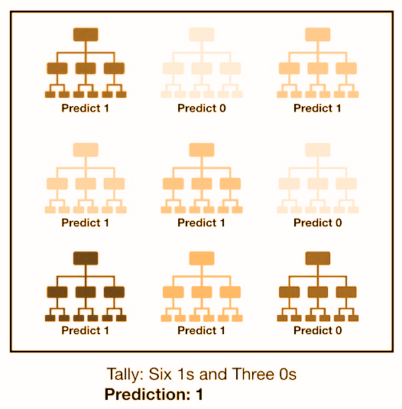
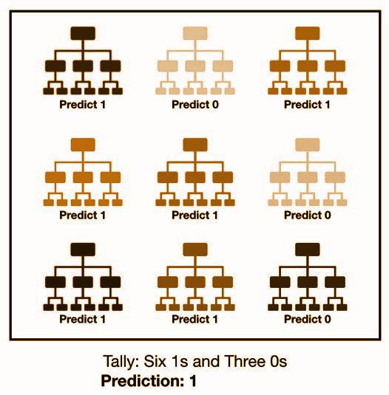
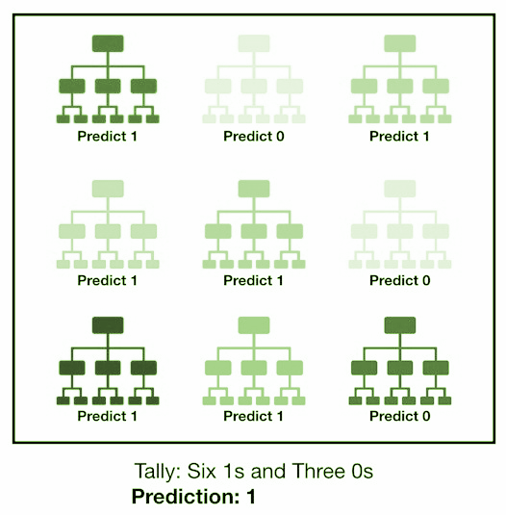
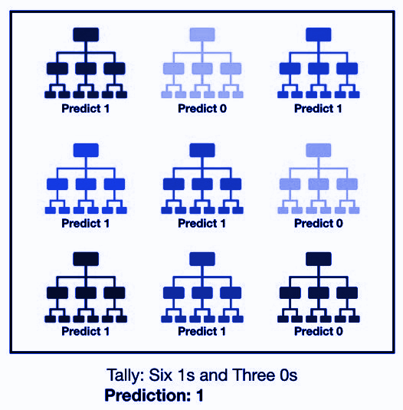
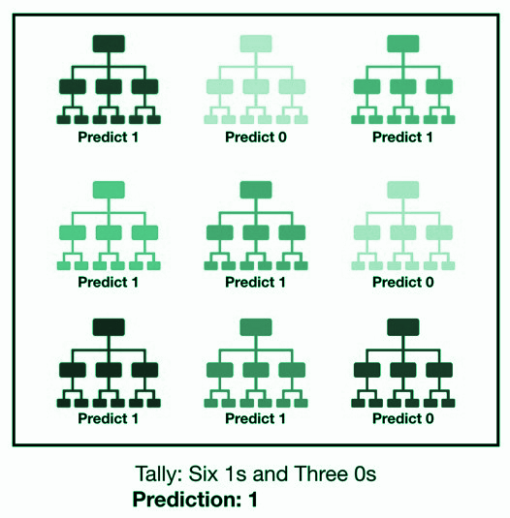
A Framework for ML solutions
Representation
The type of model we use - hypothesis space: set of all possible specific models that can be learned from the actual data
Evaluation
A measure to distinguish better and worse models
Called evaluation/objective/scoring function
F ( ) = 0.93
Optimization
A method to search in the space of models given by representation to find the best one based on evaluation
Notes:
Benedek

Slide 5
Variable types
To create a model we need data, more specifically we need input variables that the model uses to learn, we call these features
There are different types of variables, from many aspects, and it is important to recognize which is what, so we can process them accordingly
By content
By purpose
Categorical
can take only a limited selection of values, usually represented by text, but can also be represented by numbers (education level / ZIP code)
Input features
The features the model learns from
Usually needs preprocessing to bring it to the correct format:
No missing values
No text, categorical converted to numerical, etc.
Needs a great deal of care, without good features there is no good model
Numerical
represents some kind of measure,
Bool: can only take two values of opposites (true/false, woman/man)
Discrete : only makes sense if integer (# of employees, # of accidents)
Continuous: continuous numbers that can take any value (pollen concentration, body temperature)
Target variable
The variable representing what we would like to learn to predict with the model
Can be categorical (classification) or numerical (regression)
Has to be aligned with the business perspective
Date/Time
Date-time related variables, usually stored as string, can have many format, usually needs conversion
Notes:
Berta

Slide 6
Model evaluation – train-test split
In order to measure how well our model learns and generalizes, we need to separate a dataset to use for this measurement – this is data that the model has not seen during development
There are 3 options we can choose from
Train – Test Split
Train – Validation – Test Split
Cross-validation*
D E S C R
Simply split the data in two:
70-80% goes to the train set
30-20% goes to the test set
Split the dataset to 3 parts:
60% train set
20% validation set
20% test set
Split the dataset into two sets – train and test. The test remains intact, but the train set is sampled – multiple models are built on the samples and the model validation results are averaged to give a more accurate measure.
P
R O
-
C
O
N
Good option for small datasets
Test data is “seen” during hyperparameter tuning
There is no data leakage between train-test set as the validation set is used for hyperparameter tuning
Requires a “big enough” dataset
Can be used on smaller datasets as well
More accurate results on test set, can reduce overfitting
More running time and resources
I L L U S T R A T I O N
Full dataset
Full dataset
Full dataset
Test
Train
Train
Train
Train
Test
Train
Train
Train
Test
Train
Validation
Test
Train
Train
Test
Train
Train
Train
Train
Test
Notes:
Berta

Slide 7
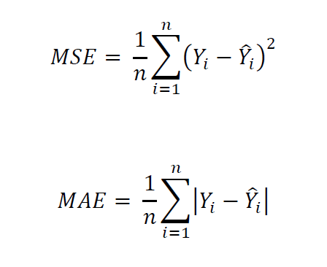
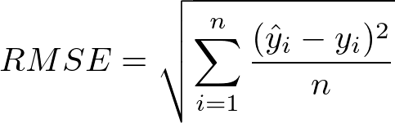
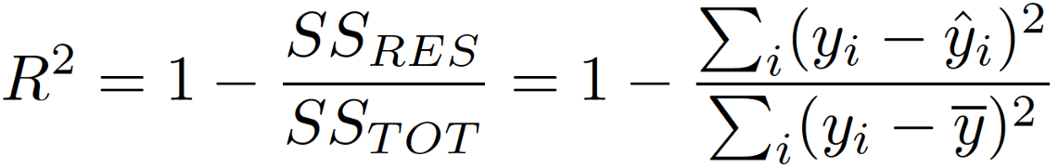
Model evaluation – regression measurement metrics
In regression we have a continuous target variable → obvious measure is the difference between the predicted and the true value → but how can we compress that into 1 value?
Typical measurement metrics for regression algorithms:
Mean Absolute Error (MAE):
The mean of the absolute error (difference between predicted and true values)
The lower, the better (the exact value will depend on the task at hand)
Mean Squared Error (MSE):
The mean of the squared error (difference between predicted and true values)
The lower, the better (the exact value will depend on the task at hand)
Root Mean Squared Error (RMSE):
the root of the mean squared error
The lower, the better (the exact value will depend on the task at hand)
R²:
Statistical measure that shows how close the data are to the fitted regression model, or in other words it represents the proportion of variance in the target variable that is predicted from the independent variables.
A number usually between 0-1 → the higher, the better → at 1 it means a perfect model
Notes:
Berta

Slide 8
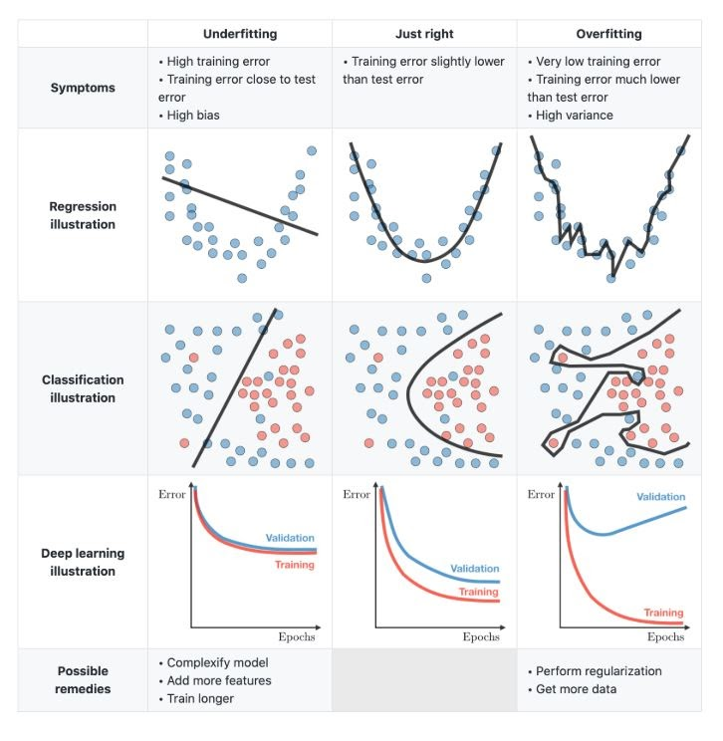
Underfitting and Overfitting
The purpose of predictive modeling is to learn the patterns and contexts of a dataset in a way that later these learned traits can help predict a previously unseen datapoint
To achieve this, we need to find the balance between underfitting and overfitting
Underfitting
Overfitting
Just right
D E S C R
Underfitting refers to a model that can neither model the training data nor generalize to new data
Overfitting is when a model learns the detail and noise in the training data to the extent that it negatively impacts the performance on new data.
Learning the patterns and context of a dataset just us much as necessary to predict well on unseen data
S
Y
M
P
T
O
M
S
High train error
Train error close to test error
High bias
Very low train error
Train error much lower than test error
High variance
Train error slightly lower than test error
I L L U S T R A T I O N
Regression
Classification
Regression
Classification
Regression
Classification
R
E M
E
D I E S
Complexify the model
Add more features
Perform regularization
Get more data
Notes:
Benedek

Slide 9
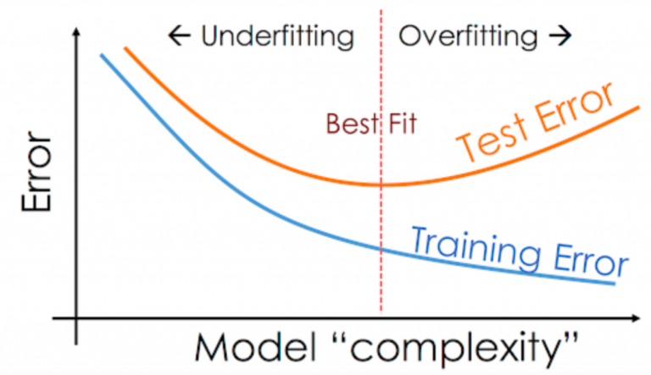
Underfitting and Overfitting
The goal is to find the optimum, where:
The difference between train-test error is small
The train error is low enough, meaning that the model has learned the patters well enough to generalize in an unseen dataset
Notes:
Benedek

Slide 10
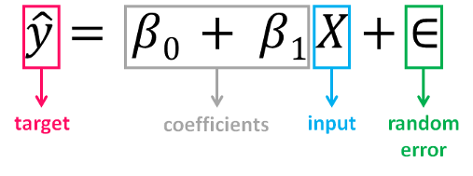
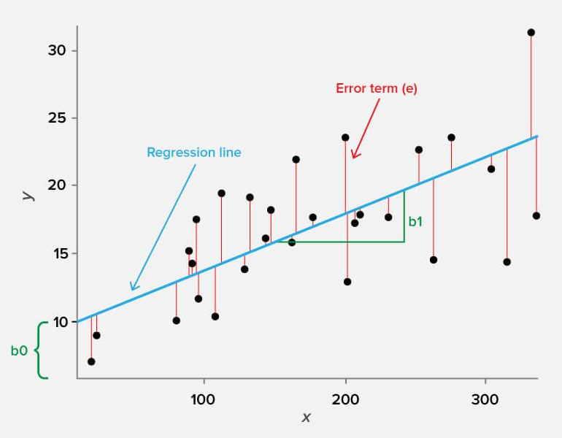
Linear Regression
Fits the “best” line (/plane/hyperplane) to the data
Best: maximizes R-squared - shows what percentage of the variance in the dependent variable is explained by the model
Representation: linear combinations of variables
Evaluation: R-squared (=MSE); other options are also feasible
Optimization: closed formula for MSE, gradient descent for other measures
Notes:
Benedek

Slide 11
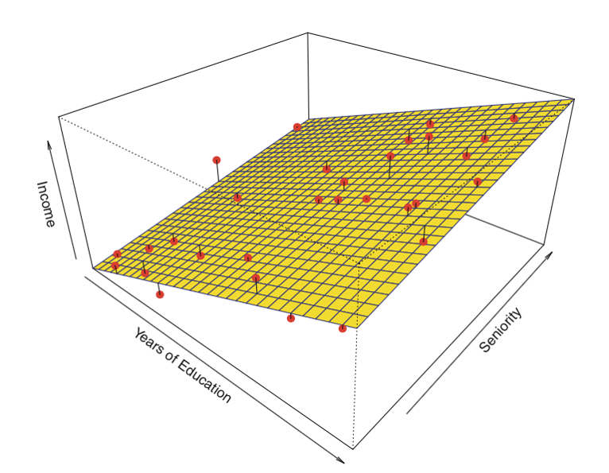
Notes:
Benedek

Slide 12


Python resources you need for solving the modeling
Packages:
Pandas
Sklearn (scikit-learn)
Pandas level:
Pd.read_csv
Pd.get_dummies
Dataframe level:
Df.Describe
Df.drop
Df.merge
Df.shape
Sklearn submodule level:
train_test_split
r2_score
mean_absolute_error
mean_squared_error
LinearRegression
Model level:
Model.fit
Model.predict
Notes:
Benedek

